Slide 1
RDBMS to Elasticsearch
The Subsonic case by
Rémi Cocula

Slide 2

Subsonic
Host your own music cloud
Stream music to desktop, mobile, Hi-Fi
[ http://www.subsonic.org ]

Slide 3
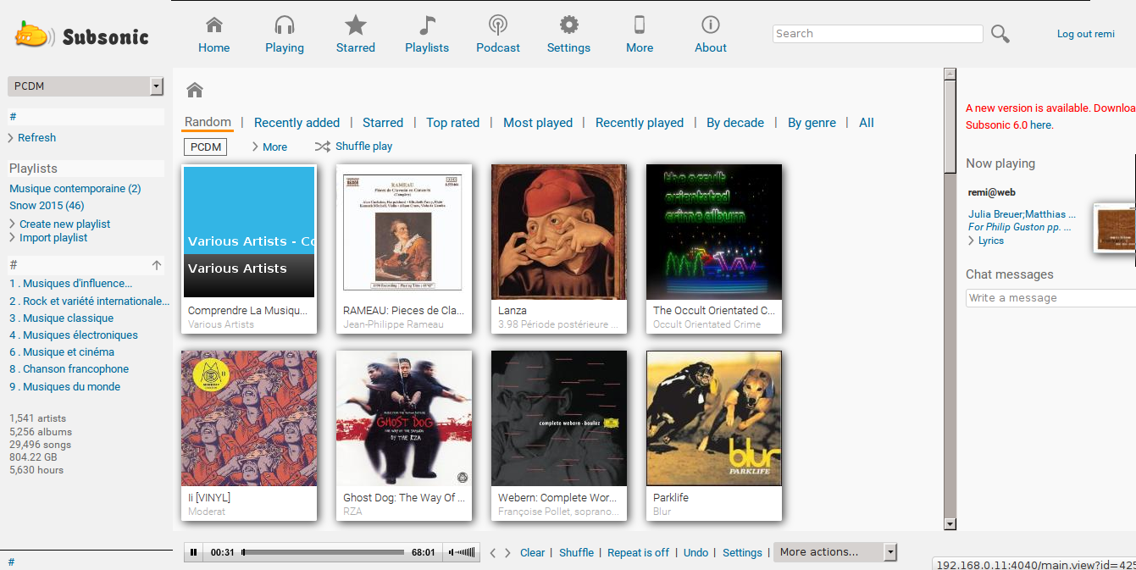
Subsonic

Slide 4
Libresonic
Subsonic is (sort of) dead ?
  Sources closed may 2016
Welcome Libresonic
  Community fork of Subsonic created may 2016
  https://github.com/Libresonic/libresonic

Slide 5
From HSQLDB to Elasticsearch
Why ?
  For fun
  Kick out RDBMS
  Optimize search
  Kibana
  Future clusturing ?

Slide 6
Elasticsearch as main storage ?
Isn't Elasticsearch a sort of distributed, document oriented, NoSQL data base ?

Slide 7
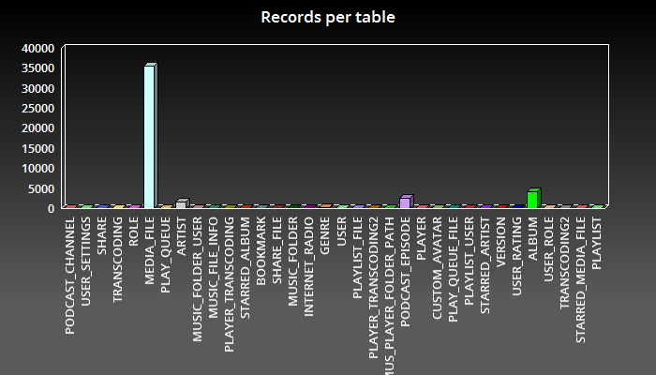
A document oriented application

Slide 8
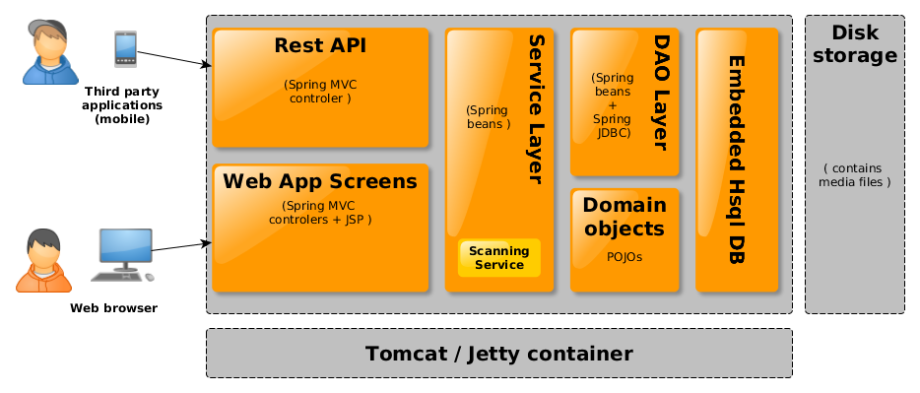
Subsonic architecture

Slide 9
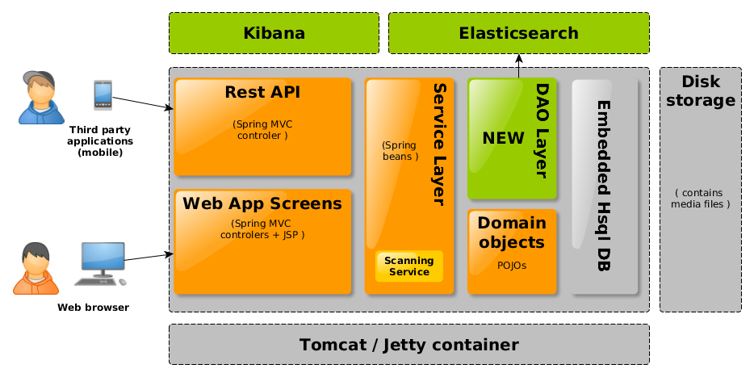
Architecture evolution

Slide 10
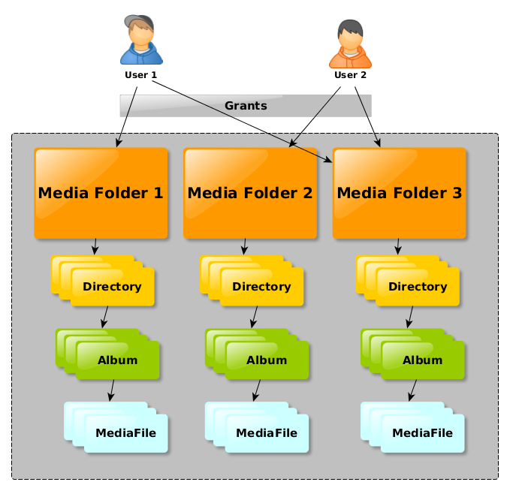
Subsonic inner organisation

Slide 11
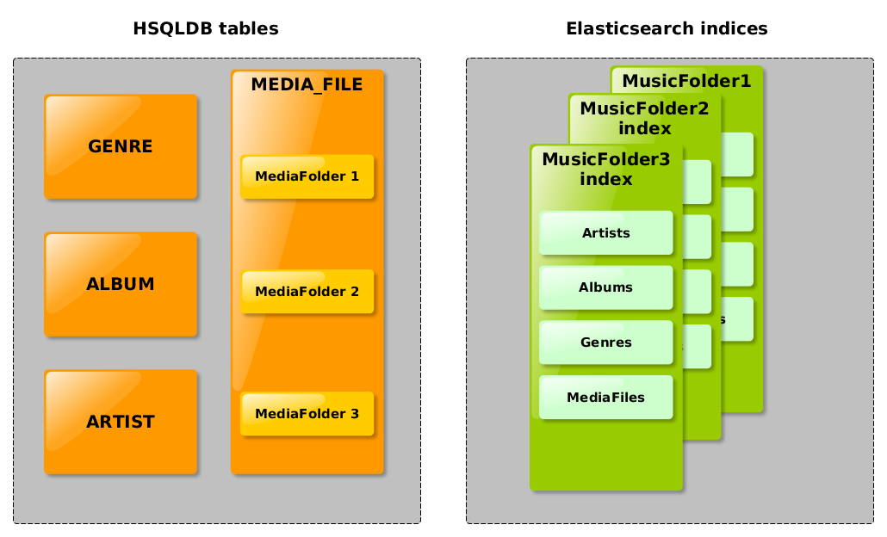
Migration strategy

Slide 12
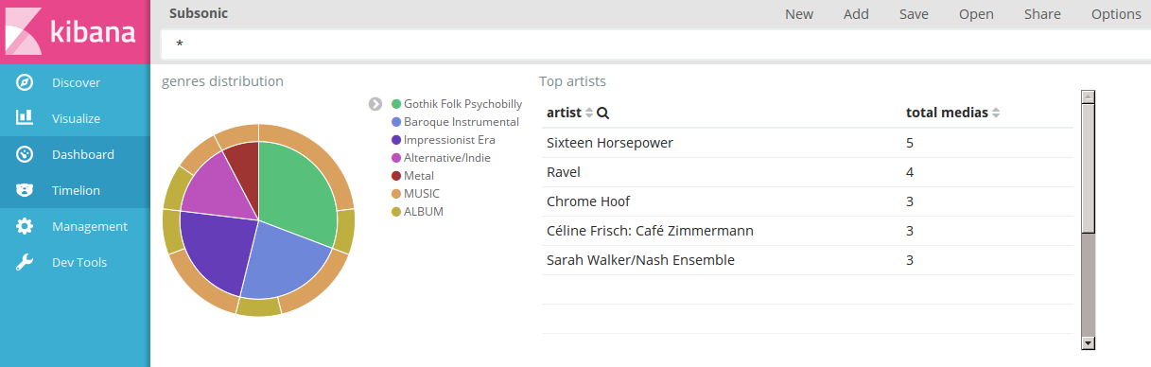
Simple Kibana dashboard

Slide 13

Let's dive into code !
No slide here, I will switch to

Slide 14


Wanna help ?
https://github.com/biconou/SubsonicES

